Slide 1


Determining Cluster of Tehsils in Delhi for Setting up Fashion Retail Stores
Shubham Jain

Slide 2
INTRODUCTION
India’s apparel market alone is estimated to be of worth $59.3 Billion by 2022
Comparable to the United Kingdom’s ($65 billion) and Germany’s ($63.1 billion)
Growth rate of fashion industry in India is driven by its increasingly growing population and increasing spending behaviour of people
Factors like literacy rate of people, population and gender also highly affect the success of a fashion brand/retail stores

Slide 3
OBJECTIVE
The project attempts to find clusters of Tehsils in Delhi where an existing/new Fashion Brands can set up their retail stores.

Slide 4
DATA DESCRIPTION
Details about Population, Literacy Rate and Sex Ratio of people living in each Tehsil of each District of Delhi is collected from the website of Census India
FourSquare API is used to get location coordinates of each Tehsil, venues in the neighbourhood of each Tehsil, user ratings of those venues etc.

Slide 5
METHODOLOGY
Fetching Data
Visualizing Tehsils of Delhi on Map
Exploring Population, Gender Ratio and Literacy in Each District of Delhi
Exploring Population, Gender Ratio and Literacy in Each Tehsil of Delhi
Exploring Venues in Delhi
Analysing Each Tehsil of Delhi
Clustering Tehsil
Examining Clusters
Finding and Visualizing Prospective Tehsils Based on a Criteria

Slide 6
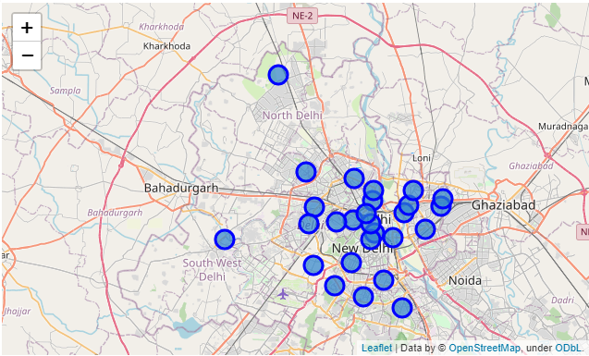
Visualizing Tehsil of Delhi on Map

Slide 7
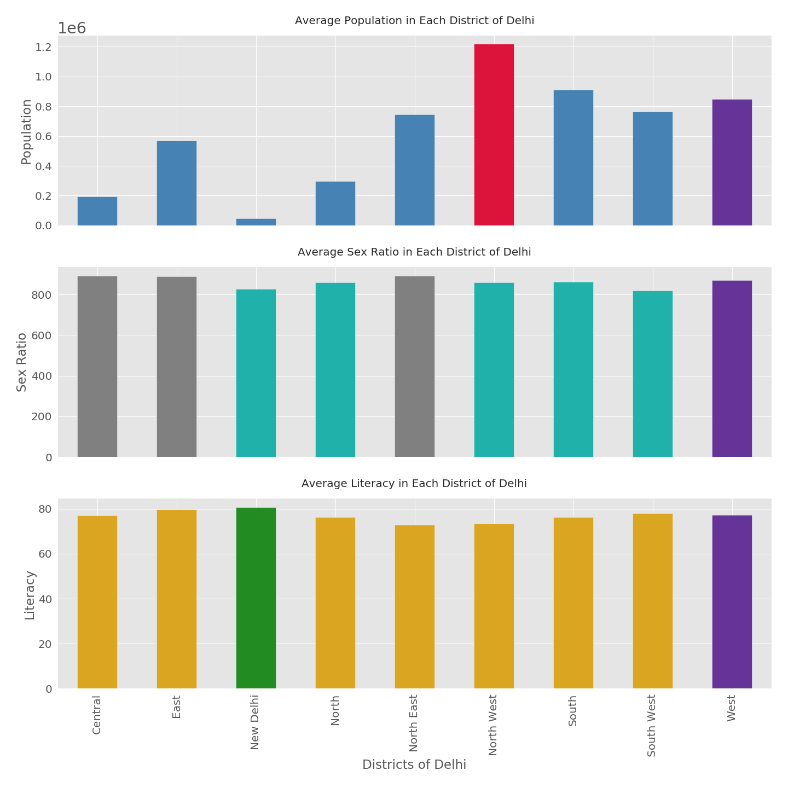
Exploring Population, Gender Ratio and Literacy in each District of Delhi
North West Delhi has highest population followed by South Delhi and then, West Delhi
Central Delhi, East Delhi and North East Delhi have highest Sex Ratio
New Delhi has highest Literacy Rate followed by East Delhi
Tehsils in West Delhi can be considered to be good locations for fashion store as they have good population size, good sex ratio and descent literacy rate

Slide 8
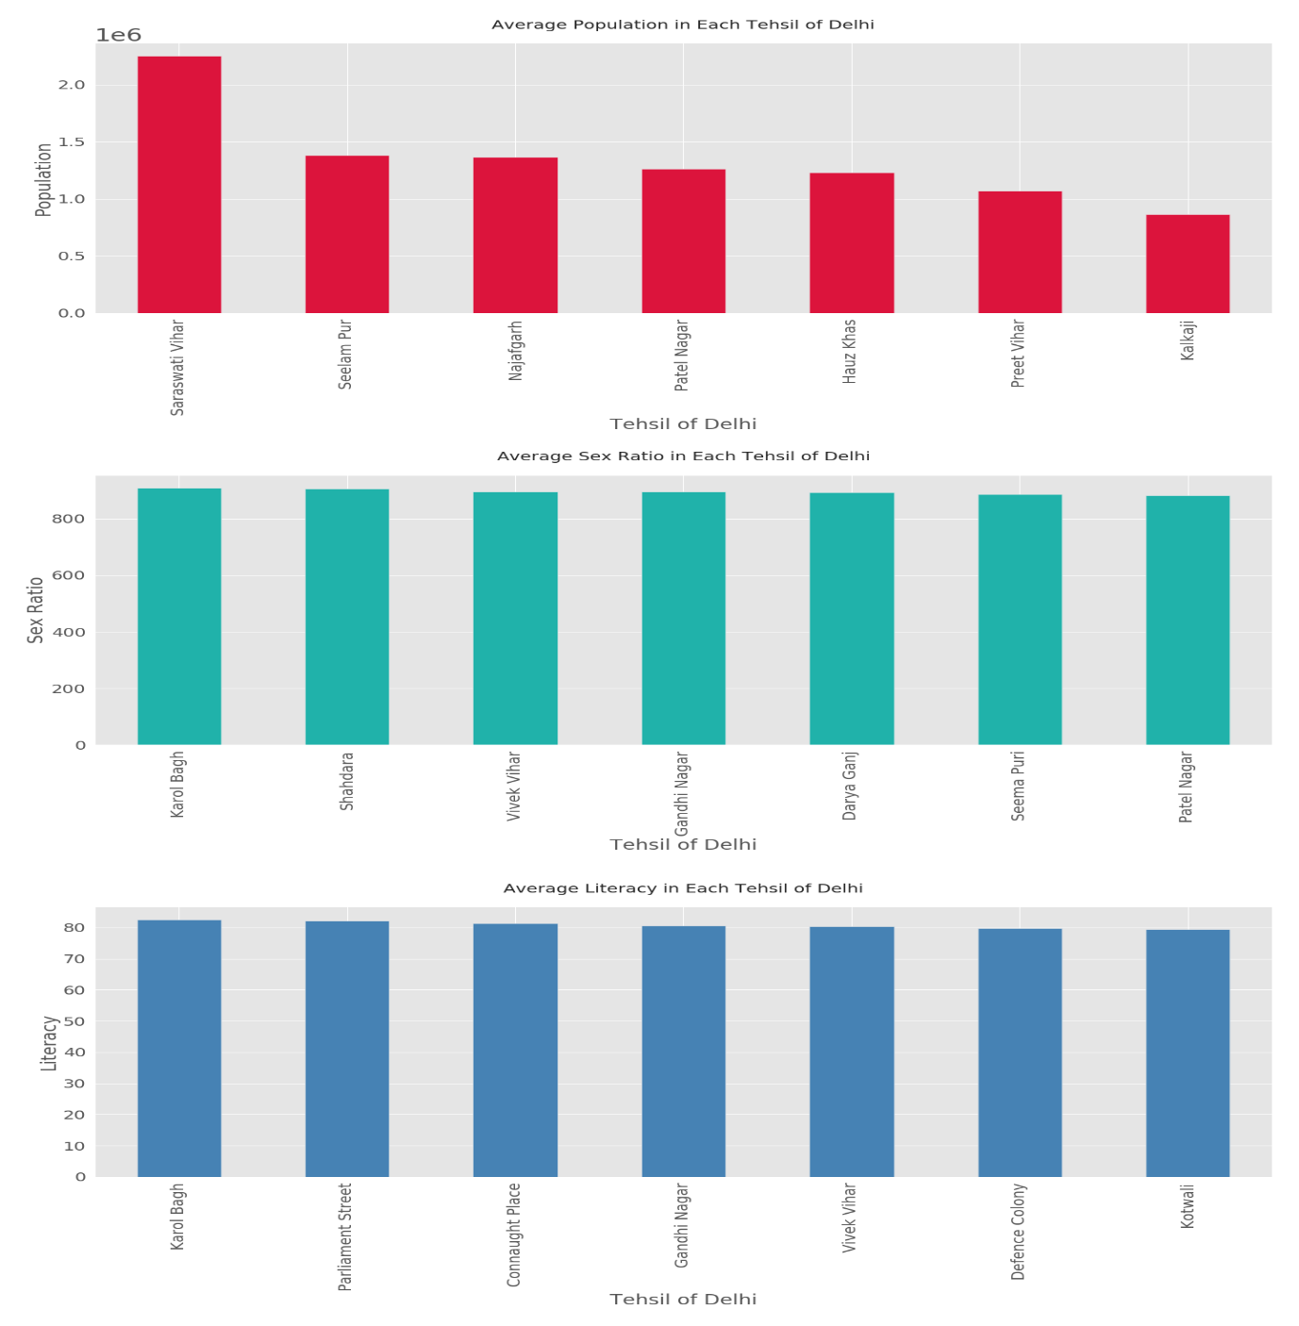
Exploring Population, Gender Ratio and Literacy in each Tehsil of Delhi
Karol Bagh has highest Literacy rate and Sex ratio. But its population size is not even in top seven
Tehsils which have high population do not have high Sex Ratio and Literacy rate

Slide 9
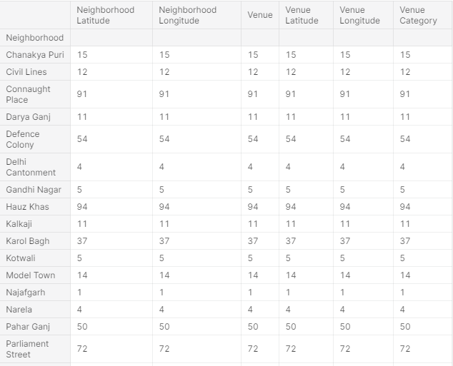
Exploring Venues in each Tehsil

Slide 10
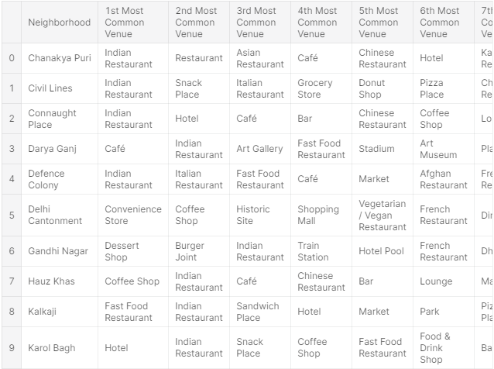
Analysing each Tehsil of Delhi

Slide 11
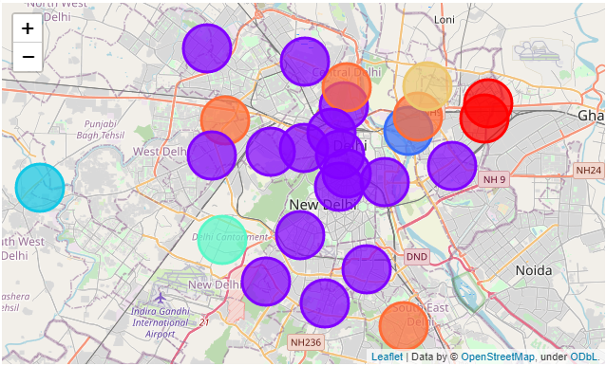
Clustering Tehsils

Slide 12
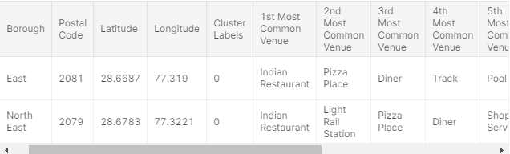
Examining Clusters
In cluster 1, tehsils that have Pizza Place, Indian Restaurant and, Shop and Service are clubbed together

Slide 13
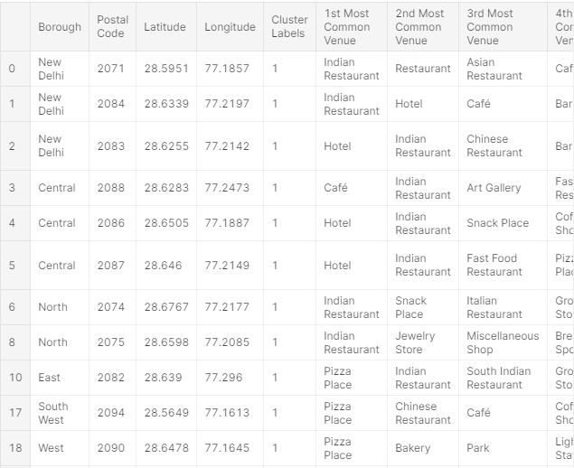
In cluster 2, Tehsils with Indian/Chinese/Italian Restaurant, cafe/coffee shop, hotel and pubs are clubbed together. This is the biggest cluster found through k-means algorithm

Slide 14
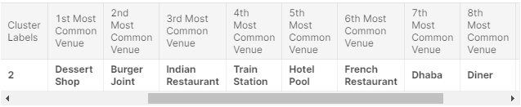
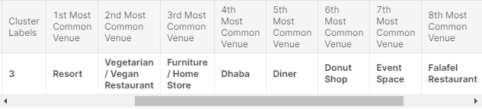
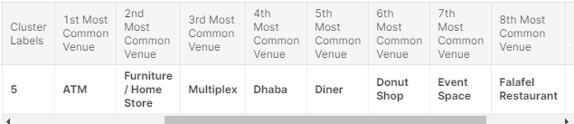
The Cluster 3, 4 and 6 have similar venues. So, they can be clubbed together. These clusters have Tehsils belonging to East Delhi, South – West Delhi and North – West Delhi.

Slide 15
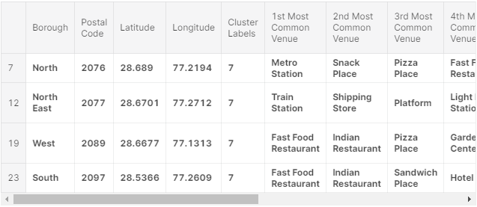
In Cluster 6, Tehsils with Pizza Place and Fast Food Restaurant are clubbed together.

Slide 16
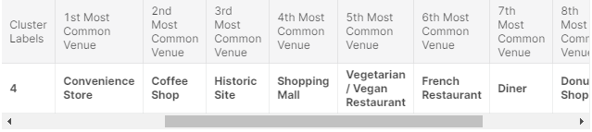
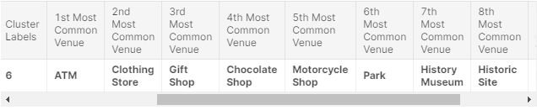
The Cluster 5 and 7 have similar venues. So, they can be clubbed together. These clusters have Tehsils belonging to South – West Delhi and North – East Delhi.

Slide 17
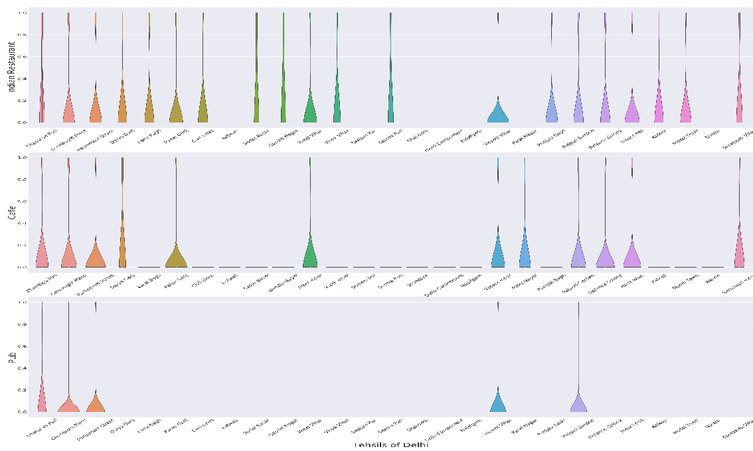
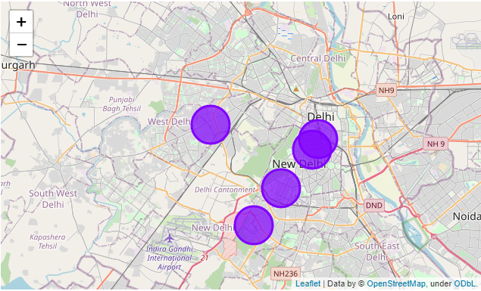
Finding and Visualizing Prospective Tehsils Based on a Criteria – Indian Restaurants, Café and Pubs

Slide 18
Conclusion
We conclude that based on certain parameters or criteria, we can select one or two clusters of Tehsils of Delhi through the above methodology for the establishment of a retail store.
There may be other ways this analysis could have been performed based on different methodolgy, different algorithm and perhaps different data sources. But I chose this method as the dataset related to tehsils in Delhi is readily available through Census India, and also, K-Means algorithm is easily able to be applied on this dataset.

Slide 19
Limitations
Area of each Tehsil can also be used for analysis.
Data related to centennials and millennials can be employed for decision-making and, thus can be used for further analysis.
Fashion Brands famous or trending in a particular tehsil can also be helpful to decide better locations for establishment of fashion retail stores.

Slide 20
THANK YOU

